Slide 1
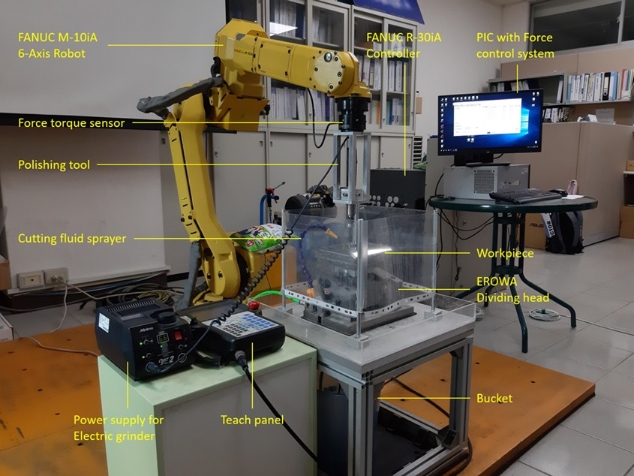
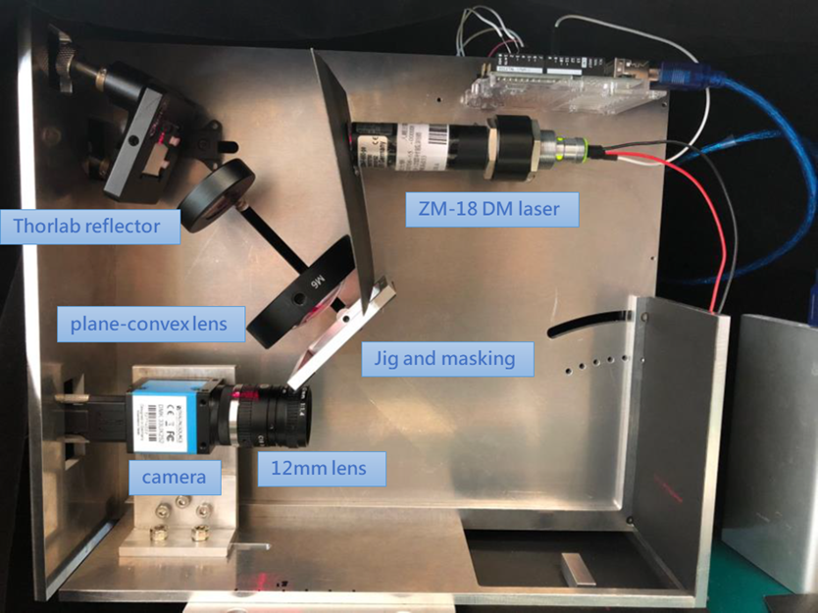
Opto-Mechatronics Technology Center (OMTC)
OMTC aims to develop the opto-mechatronic systems, integrated with optical, mechanical, electronic, and information technologies, to enhance the mechatronic education and promote the university-industry collaboration.
Intelligent robot-assisted polishing system with constant force control for medium-sized workpiece
Portable non-contact intelligent surface roughness and profile measuring system

